Slide 1
LIFE OF CHRIST

Slide 2
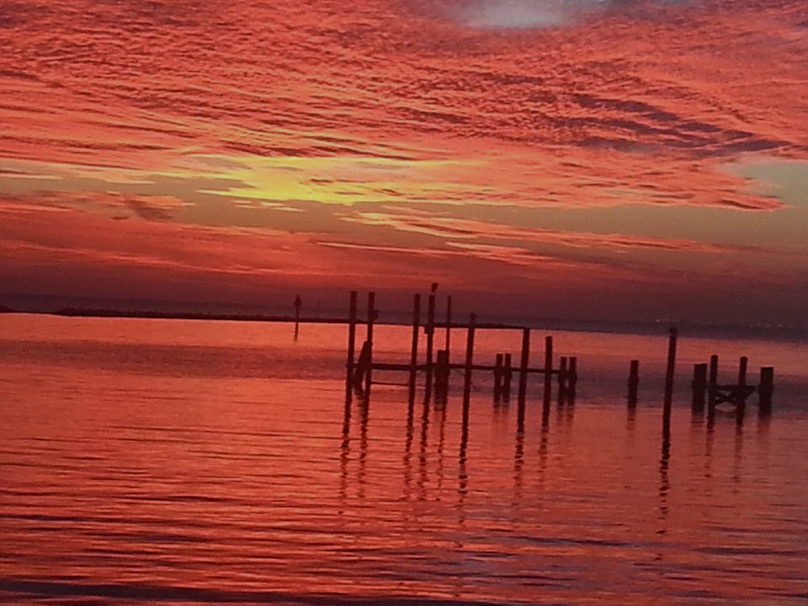
The wicked vinedressers
Mt. 21:33-46; Mk. 12:1-12; Lk. 20:9-18.

Slide 3
Matthew 21:33 " Hear another parable: There was a certain landowner who planted a vineyard and set a hedge around it, dug a winepress in it and built a tower. And he leased it to vinedressers and went into a far country. ³⁴ "Now when vintage-time drew near, he sent his servants to the vinedressers, that they might receive its fruit. ³⁵ "And the vinedressers took his servants, beat one, killed one, and stoned another. ³⁶ "Again he sent other servants, more than the first, and they did likewise to them.

Slide 4
³⁷ "Then last of all he sent his son to them, saying, 'They will respect my son.' ³⁸ "But when the vinedressers saw the son, they said among themselves, 'This is the heir. Come, let us kill him and seize his inheritance.' ³⁹ "So they took him and cast him out of the vineyard and killed him. ⁴⁰ "Therefore, when the owner of the vineyard comes, what will he do to those vinedressers?" ⁴¹ They said to Him, "He will destroy those wicked men miserably, and lease his vineyard to other vinedressers who will render to him the fruits in their seasons."

Slide 5
Mark 12:2 "Now at vintage-time he sent a servant to the vinedressers, that he might receive some of the fruit of the vineyard from the vinedressers. ³ "And they took him and beat him and sent him away empty-handed. ⁴ "Again he sent them another servant, and at him they threw stones, wounded him in the head, and sent him away shamefully treated. ⁵ "And again he sent another, and him they killed; and many others, beating some and killing some.

Slide 6
Isaiah 5:1 Now let me sing to my Well-beloved A song of my Beloved regarding His vineyard: My Well-beloved has a vineyard On a very fruitful hill. ² He dug it up and cleared out its stones, And planted it with the choicest vine. He built a tower in its midst, And also made a winepress in it; So He expected it to bring forth good grapes, But it brought forth wild grapes. ³ " And now, O inhabitants of Jerusalem and men of Judah, Judge, please, between Me and My vineyard.

Slide 7
⁴ What more could have been done to My vineyard That I have not done in it? Why then, when I expected it to bring forth good grapes, Did it bring forth wild grapes? ⁵ And now, please let Me tell you what I will do to My vineyard: I will take away its hedge, and it shall be burned; And break down its wall, and it shall be trampled down. ⁶ I will lay it waste; It shall not be pruned or dug, But there shall come up briers and thorns. I will also command the clouds That they rain no rain on it." ⁷ For the vineyard of the LORD of hosts is the house of Israel, And the men of Judah are His pleasant plant. He looked for justice, but behold, oppression; For righteousness, but behold, a cry for help.

Slide 8
There was a certain landowner who planted a vineyard and set a hedge around it, dug a winepress in it and built a tower.

Slide 9
And he leased it to vinedressers and went into a far country.

Slide 10
³⁴ "Now when vintage-time drew near, he sent his servants to the vinedressers, that they might receive its fruit. ³⁵ "And the vinedressers took his servants, beat one, killed one, and stoned another. ³⁶ "Again he sent other servants, more than the first, and they did likewise to them. ³⁷ "Then last of all he sent his son to them, saying, 'They will respect my son.' ³⁸ "But when the vinedressers saw the son, they said among themselves, 'This is the heir. Come, let us kill him and seize his inheritance.' ³⁹ "So they took him and cast him out of the vineyard and killed him.

Slide 11
Song of Solomon 8:11 Solomon had a vineyard at Baal Hamon; He leased the vineyard to keepers; Everyone was to bring for its fruit A thousand silver coins. (TO SOLOMON) ¹² My own vineyard is before me. You, O Solomon, may have a thousand, And those who tend its fruit two hundred.

Slide 12
If he did not collect some of the produce within a specified time, he risked losing ownership of the vineyard; the tenants could make a legitimate claim to it. According to the Mishnah, one could establish his ownership of the vineyard if he could prove undisputed possession for three years or three harvest seasons. This process is referred to as hazakah. However, by collecting fruit from the tenants, a landowner removed any doubt about his possession.

Slide 13
Morris wrote, “In a new vineyard there would not be very much yield until the fourth year and no great profit until the fifth… The owner was establishing his position by collecting his rent, even if it was no more than a nominal amount, during the years that the vineyard was being established.” (Truth for Today Commentary, p. 233-234).

Slide 14
⁴⁰ "Therefore, when the owner of the vineyard comes, what will he do to those vinedressers?" ⁴¹ They said to Him, "He will destroy those wicked men miserably, and lease his vineyard to other vinedressers who will render to him the fruits in their seasons."

Slide 15
Matthew 21:42 Jesus said to them, "Have you never read in the Scriptures: 'The stone which the builders rejected Has become the chief cornerstone. This was the LORD's doing, And it is marvelous in our eyes'? ⁴³ "Therefore I say to you, the kingdom of God will be taken from you and given to a nation bearing the fruits of it. ⁴⁴ "And whoever falls on this stone will be broken; but on whomever it falls, it will grind him to powder." ⁴⁵ Now when the chief priests and Pharisees heard His parables, they perceived that He was speaking of them. ⁴⁶ But when they sought to lay hands on Him, they feared the multitudes, because they took Him for a prophet.

Slide 16
It does not take much to conclude that Jesus is the chief cornerstone, and He is the foundation of the church (Acts 4:8-12). Everything must be built upon Him (Eph. 2:20-22).

Slide 17
Matthew 22:1 And Jesus answered and spoke to them again by parables and said: ² "The kingdom of heaven is like a certain king who arranged a marriage for his son, ³ "and sent out his servants to call those who were invited to the wedding; and they were not willing to come. ⁴ "Again, he sent out other servants, saying, 'Tell those who are invited, "See, I have prepared my dinner; my oxen and fatted cattle are killed, and all things are ready. Come to the wedding." ' ⁵ "But they made light of it and went their ways, one to his own farm, another to his business.

Slide 18
⁶ "And the rest seized his servants, treated them spitefully, and killed them. ⁷ "But when the king heard about it, he was furious. And he sent out his armies, destroyed those murderers, and burned up their city. ⁸ "Then he said to his servants, 'The wedding is ready, but those who were invited were not worthy. ⁹ 'Therefore go into the highways, and as many as you find, invite to the wedding.' ¹⁰ "So those servants went out into the highways and gathered together all whom they found, both bad and good. And the wedding hall was filled with guests.

Slide 19
¹¹ "But when the king came in to see the guests, he saw a man there who did not have on a wedding garment. ¹² "So he said to him, 'Friend, how did you come in here without a wedding garment?' And he was speechless. ¹³ "Then the king said to the servants, 'Bind him hand and foot, take him away, and cast him into outer darkness; there will be weeping and gnashing of teeth.' ¹⁴ "For many are called, but few are chosen."

Slide 20
2 Thessalonians 1:7 and to give you who are troubled rest with us when the Lord Jesus is revealed from heaven with His mighty angels, ⁸ in flaming fire taking vengeance on those who do not know God, and on those who do not obey the gospel of our Lord Jesus Christ. ⁹ These shall be punished with everlasting destruction from the presence of the Lord and from the glory of His power, ¹⁰ when He comes, in that Day, to be glorified in His saints and to be admired among all those who believe, because our testimony among you was believed.

Slide 21
⁸ "Then he said to his servants, 'The wedding is ready, but those who were invited were not worthy. ⁹ 'Therefore go into the highways, and as many as you find, invite to the wedding.' ¹⁰ "So those servants went out into the highways and gathered together all whom they found, both bad and good. And the wedding hall was filled with guests.

Slide 22
Romans 15:8 Now I say that Jesus Christ has become a servant to the circumcision for the truth of God, to confirm the promises made to the fathers, ⁹ and that the Gentiles might glorify God for His mercy, as it is written: "For this reason I will confess to You among the Gentiles, And sing to Your name." ¹⁰ And again he says: "Rejoice, O Gentiles, with His people!" ¹¹ And again: "Praise the LORD, all you Gentiles! Laud Him, all you peoples!" ¹² And again, Isaiah says: "There shall be a root of Jesse; And He who shall rise to reign over the Gentiles, In Him the Gentiles shall hope."

Slide 23
Matthew 22:11 "But when the king came in to see the guests, he saw a man there who did not have on a wedding garment. ¹² "So he said to him, 'Friend, how did you come in here without a wedding garment?' And he was speechless. ¹³ "Then the king said to the servants, 'Bind him hand and foot, take him away, and cast him into outer darkness; there will be weeping and gnashing of teeth.' ¹⁴ "For many are called, but few are chosen."

Slide 24
Romans 13:14 But put on the Lord Jesus Christ, and make no provision for the flesh, to fulfill its lusts.

Slide 25
Galatians 3:27 For as many of you as were baptized into Christ have put on Christ.
Romans 6:3 Or do you not know that as many of us as were baptized into Christ Jesus were baptized into His death?

Slide 26
Colossians 3:5 Therefore put to death your members which are on the earth: fornication, uncleanness, passion, evil desire, and covetousness, which is idolatry. ⁶ Because of these things the wrath of God is coming upon the sons of disobedience, ⁷ in which you yourselves once walked when you lived in them. ⁸ But now you yourselves are to put off all these: anger, wrath, malice, blasphemy, filthy language out of your mouth. ⁹ Do not lie to one another, since you have put off the old man with his deeds,

Slide 27
¹⁰ and have put on the new man who is renewed in knowledge according to the image of Him who created him, ¹¹ where there is neither Greek nor Jew, circumcised nor uncircumcised, barbarian, Scythian, slave nor free, but Christ is all and in all. ¹² Therefore, as the elect of God, holy and beloved, put on tender mercies, kindness, humility, meekness, longsuffering; ¹³ bearing with one another, and forgiving one another, if anyone has a complaint against another; even as Christ forgave you, so you also must do. ¹⁴ But above all these things put on love, which is the bond of perfection.

Slide 28
1 John 2:23 Whoever denies the Son does not have the Father either; he who acknowledges the Son has the Father also.

Slide 29
¹⁴ "For many are called, but few are chosen.“
The question becomes, will you accept the gospel call or will you reject it?
If you have accepted the gospel call, will you continue in it?

